Slide 1
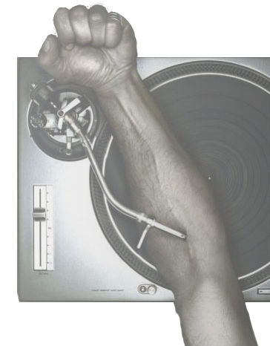
How to get your fix of music ?

Slide 2
Contents
I. Everyone loves music
II. It’s becoming hard to get your dose
III. But there are still ways to find it

Slide 3



I. Everyone loves music
March 2001 - 2005
June 1999 – July 2001
September 2000 - Today

Slide 4



2003 - 2007
August 2003 - Today
August 2007 - Today

Slide 5
II. It’s becoming hard to get your dose
DADVSI, 2006
HADOPI, 2009
HADOPI II, 2009

Slide 6



III. But there are still ways to find it

Slide 7
References
http://www.slate.fr/ http://www.slate.com/
http://fr.wikipedia.org/ http://en.wikipedia.org/
http://www.senat.fr/
http://www.spotify.com/
http://www.deezer.com/
http://www.kazaa.com/
http://free.napster.com/

Slide 8


